Slide 1
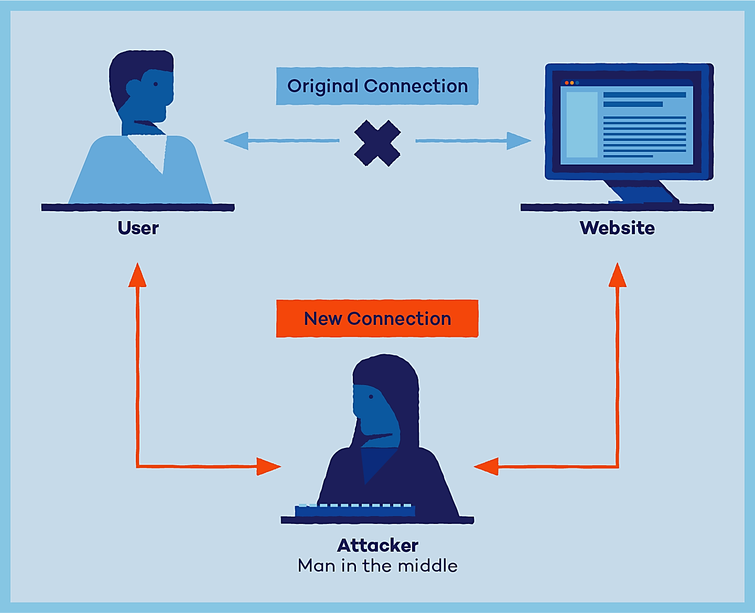
Man In The Middle Attack (MITM)
Enterprise Digital Infrastructure (EDI)
Team members:
Faezeh Vakili
Sahar Taheri moghadar
Behnaz Amiri
Sepideh Hayati
Alireza khornegah
University Of PAVIA
Spring 2023

Slide 2

What is MITM attack?
A form of cyber attack
Exploiting weak web-based protocols
Insert between entities
Steal data

Slide 3

1. Email Hijacking
control of the email accounts of banks
financial institutions
other trusted companies
attackers can monitor transactions
correspondence between the bank and its customers
more malicious scenarios
Attackers spoof, or fake bank's email address
send customers emails
resend their credentials
send money

Slide 4

2. Wi-Fi Eavesdropping
connect to a nearby wireless network
a legitimate-sounding name
Engaging in malicious activity
seemingly harmless name
"Free Public Wi-Fi Network"
Attacker options:
monitor the user's online activity
scrape login credentials

Slide 5
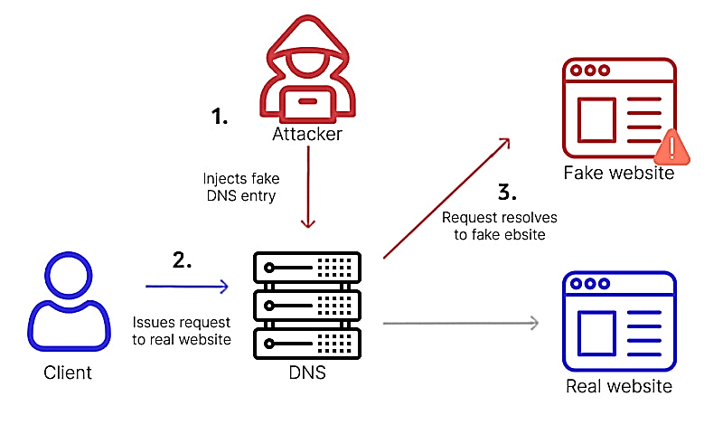
3. DNS Spoofing
Notes:
occurs when manipulated DNS records are used to divert legitimate online traffic to a fake or spoofed website built to resemble a website the user would most likely know and trust.
As with all spoofing techniques, attackers prompt users to log in unwittingly to the fake website and convince them that they need to take a specific action, such as pay a fee or transfer money to a specific account. The attackers steal as much data as they can from the victims in the process.

Slide 6

4. Session Hijacking
waits for a victim to log in
steals the session cookie
uses the cookie to log in
attackers need to work quickly
sessions expire

Slide 7
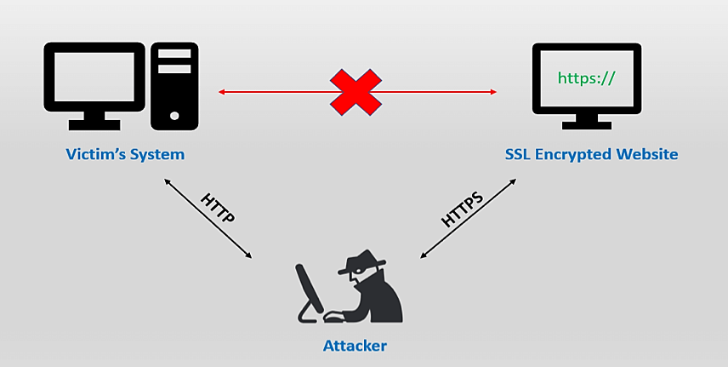
5. Secure Sockets Layer (SSL) Hijacking
protocols for establishing security
networked computers
intercepts all passing data
server and the user’s computer
vulnerable security protocol

Slide 8
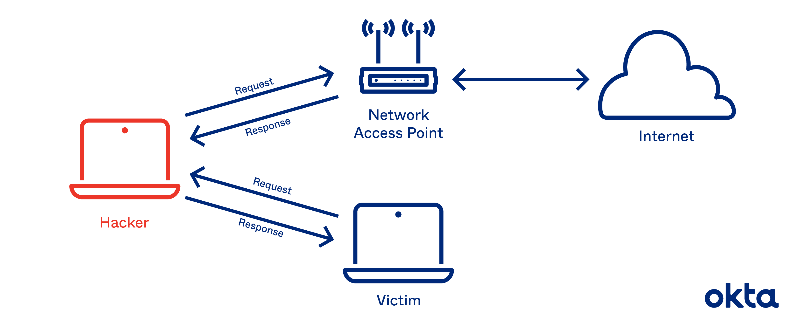
6. ARP Cache Poisoning
thinking that the fraudster's computer is the network gateway
sends all of its network traffic to the malicious actor
attacker utilizes this diverted traffic
analyze and steal all the information they need

Slide 9

What is ARP protocol?
The Address Resolution Protocol
Data packet
Source IP address | Source MAC address | Destination MAC address | Destination IP address

Slide 10
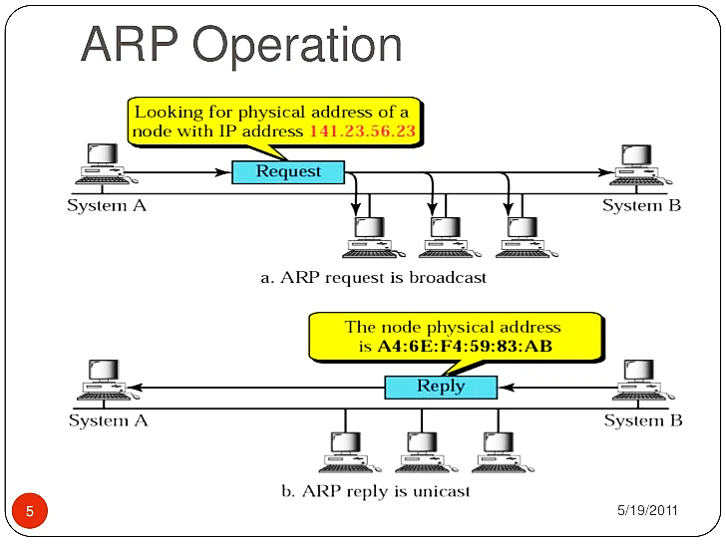
How does the ARP protocol work?
At first, the device looks at the source in its cache, maybe it has already been saved.
If there is no MAC address in the cache, the device will send a request to all the devices in the network.

Slide 11

The weak point for ARP protocol
The ARP protocol was not designed for security, so it does not verify that a response to an ARP request really comes from an authorized party. This is a weak point in the ARP protocol, which opens the door to ARP spoofing attacks.

Slide 12
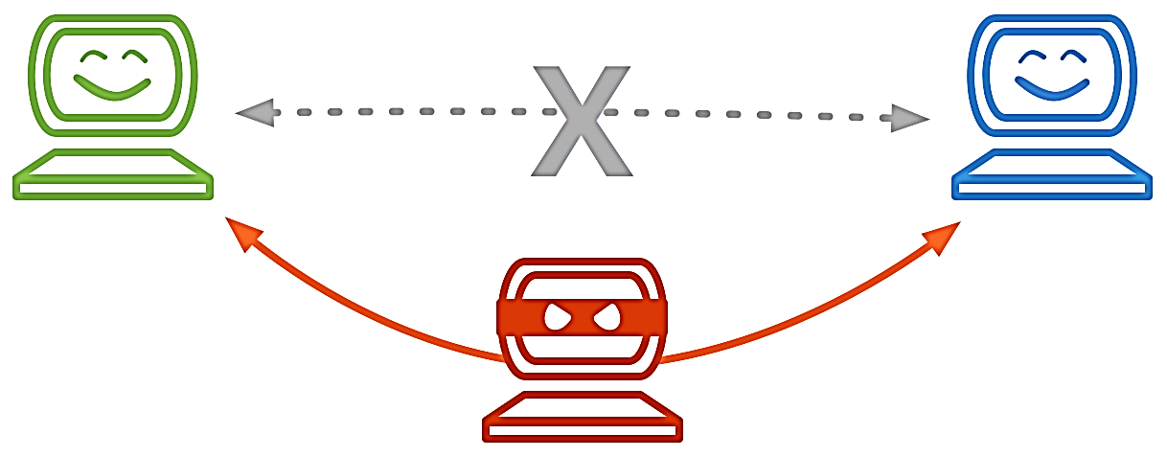
What is ARP spoofing ?
ARP spoofing, also known as ARP poisoning or ARP cache poisoning, is a network attack technique where an attacker sends falsified Address Resolution Protocol (ARP) messages on a local area network (LAN).

Slide 13
What should attacker do?
Identify the target network
Obtain the target’s IP address
Launch ARP spoofing attack
Poison ARP cashes
Intercept or manipulate network traffic
Carry out malicious activities

Slide 14
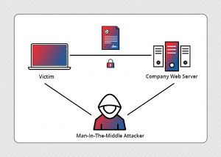
When the attacker succeed in an ARP spoofing ,they can:
1.
Man in the middle attack
2.
Packet sniffing

Slide 15
When the attacker succeed in an ARP spoofing ,they can:
3.
Dos attacks⁠
4.
DNS snoofing

Slide 16


What do you need to set up a MITM attack?
Notes:
I want to talk about implementation of MITM attack.
In this case we used kali Linux and Ettercap .
And also we can installing Ettercap on another distribution of Linux
To carry out the attack, you would need to set up your system with Kali Linux and install Ettercap on it. Kali Linux provides a platform with pre-installed tools that are commonly used for ethical hacking and security testing.

Slide 17


How can we setup this attack?
Using Ettercap
Using Wireshark
Notes:
We will examine two methods here. I explain …

Slide 18

How can we setup this attack?
Using Ettercap
Notes:
I start with explain …

Slide 19

What is Ettercap
The most frequent use of Ettercap is to set up man-in-the-middle attacks using ARP poisoning.
Notes:
Ettercap is a free tool that lets us control communication between devices on a network.
And also it can be used for the protocol analysis, necessary to analyze network traffic.
With Ettercap, we connect to the network, identify hosts, specify targets, and launch the attack.

Slide 20
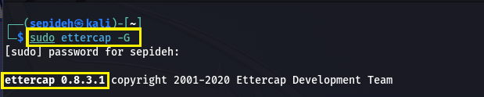
Enter to Ettercap
Notes:
To launch Ettercap, enter the command shown in the picture below.

Slide 21
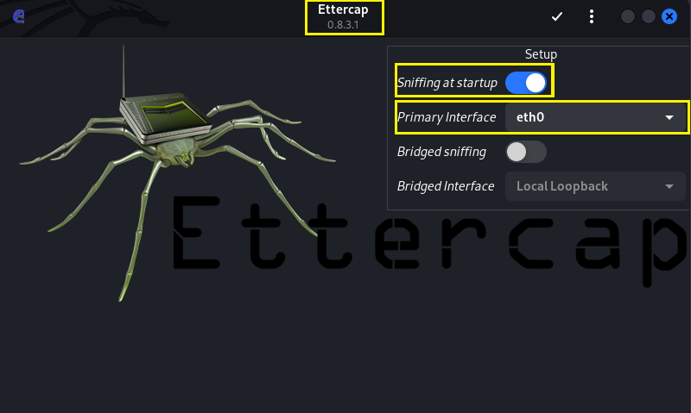
B. A view of the Ettercap tool and Select Network Interface to Sniff On
Notes:
In the Ettercap tool, we'll see the main screen with the logo and drop-down menus. We Select the “network interface connected” to the network you're attacking.

Slide 22
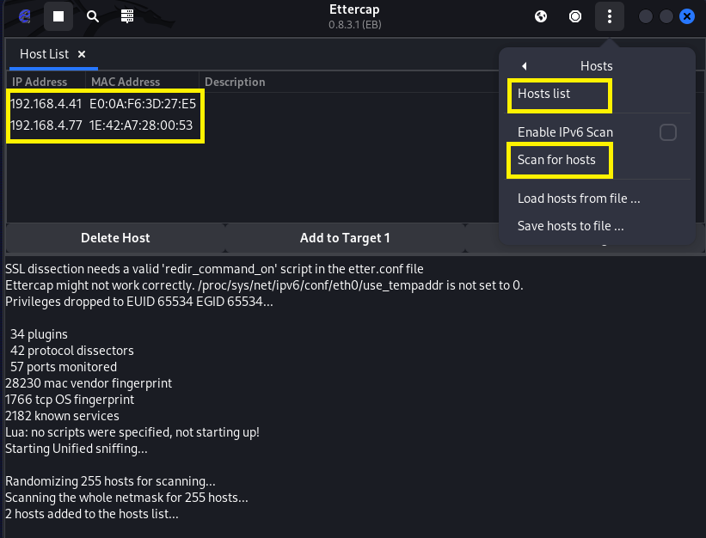
D. Identifying and Listing Hosts on a Network.
Notes:
To find the target device on the network, click "Hosts" and scan for hosts.
Now here we can see the list of IPs and choose the IPs

Slide 23
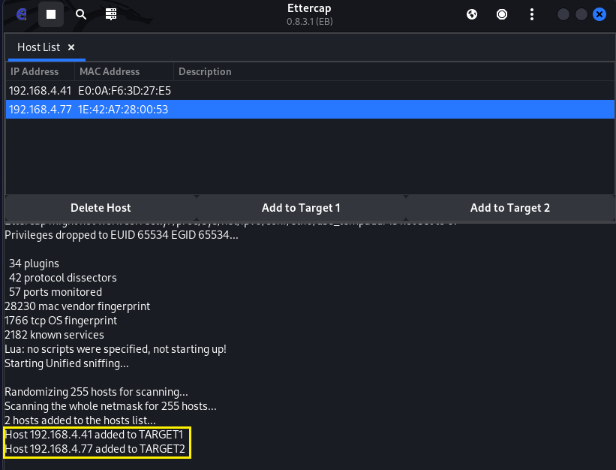
E. Select Hosts to Target with ARP Spoofing
Notes:
In this level we can choose the targets..

Slide 24
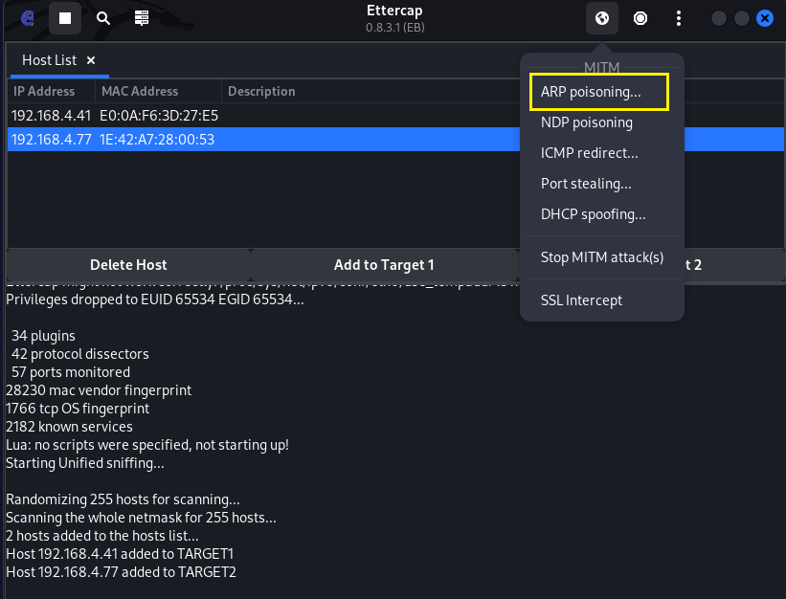
F. Launch Attack on Targets (choosing one of the attacks MITM)
Notes:
Click on the "Mitm" menu, and select "ARP poisoning."

Slide 25
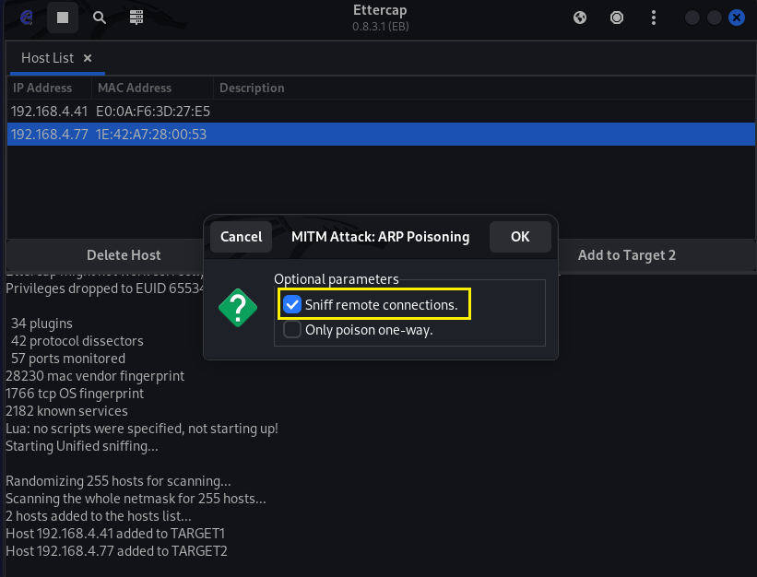
G. Choosing Sniff remote
Notes:
A popup will open, and you'll select "Sniff remote connections" to begin the sniffing attack.

Slide 26
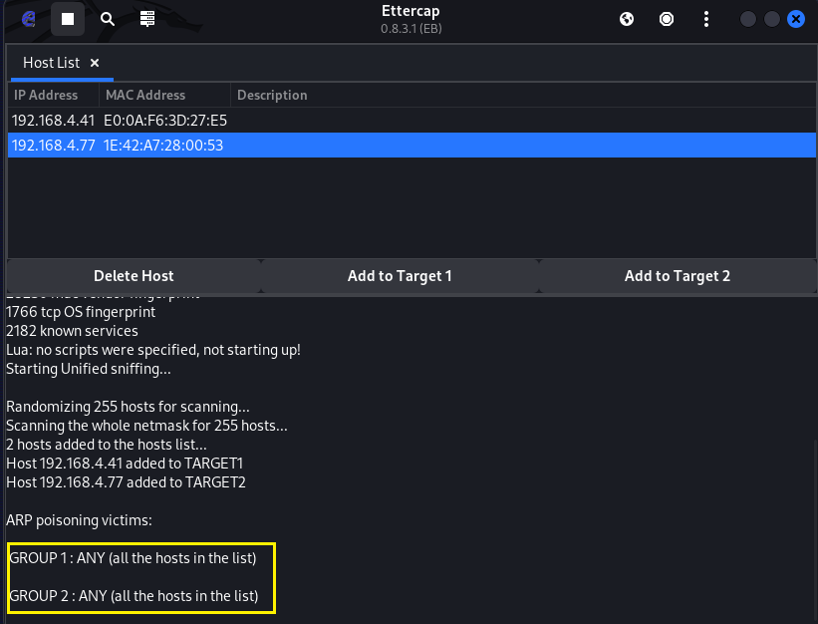

H. Grouping Hosts
Notes:
Here we can see the groups

Slide 27
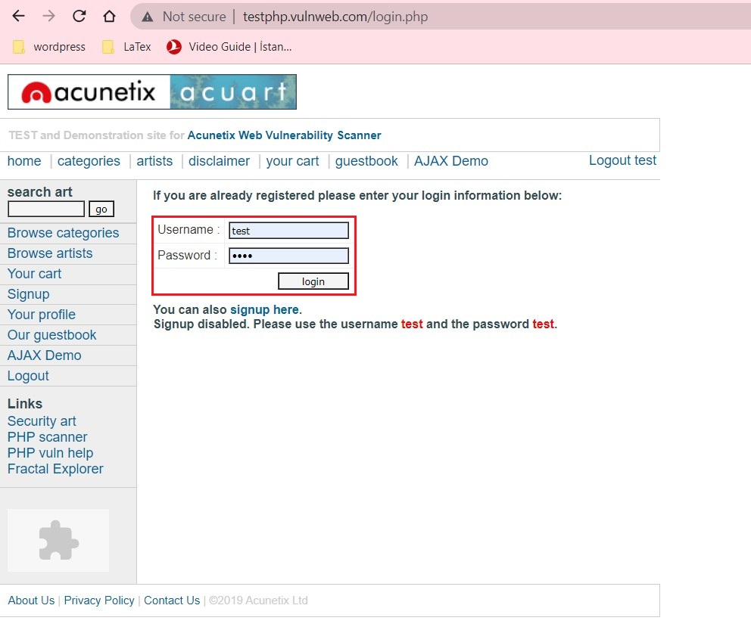
I. Users are browsing and signing up.
Notes:
User enter the username and password on the insecure site…

Slide 28
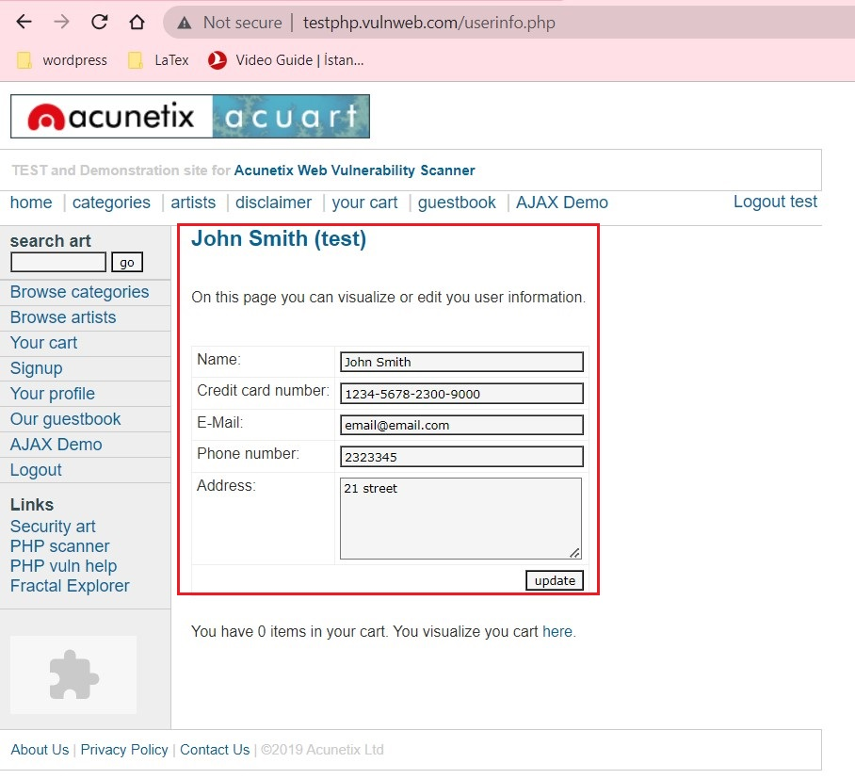
j. User has entered.
Notes:
We are following the information..

Slide 29

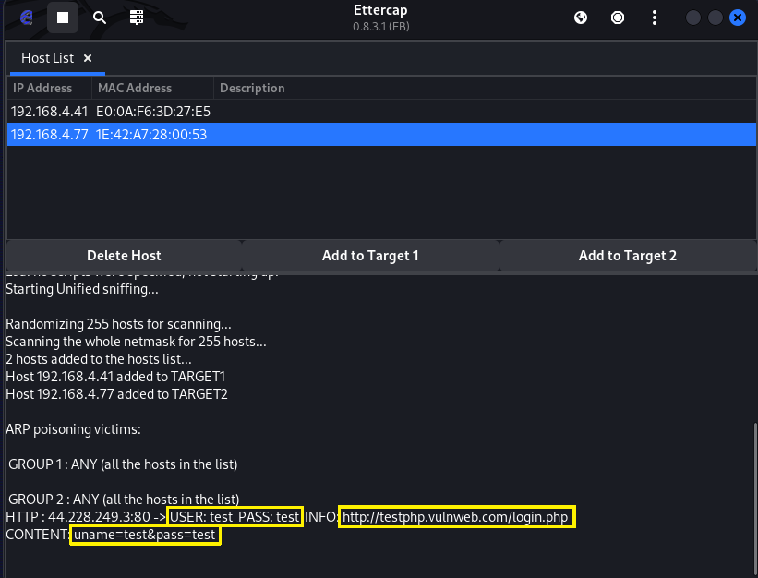

K. catching Data from User's Browser
Notes:
And The process is finished, so Now we can see the result ..

Slide 30

How can we setup this attack?
Using Wireshark
Notes:
Now I want to explain wireshark..
Wireshark is a free and open-source packet analyzer. It is used for network troubleshooting, analysis, software and communications protocol development, and education.

Slide 31
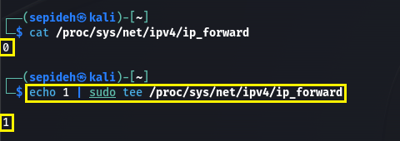
A. IP forwarding
Notes:
We must be routers so We want to become router by typing this command and you can see the same result like Ettercap by using wireshark.. Now we are going to have a practical implementation by sepideh.

Slide 32
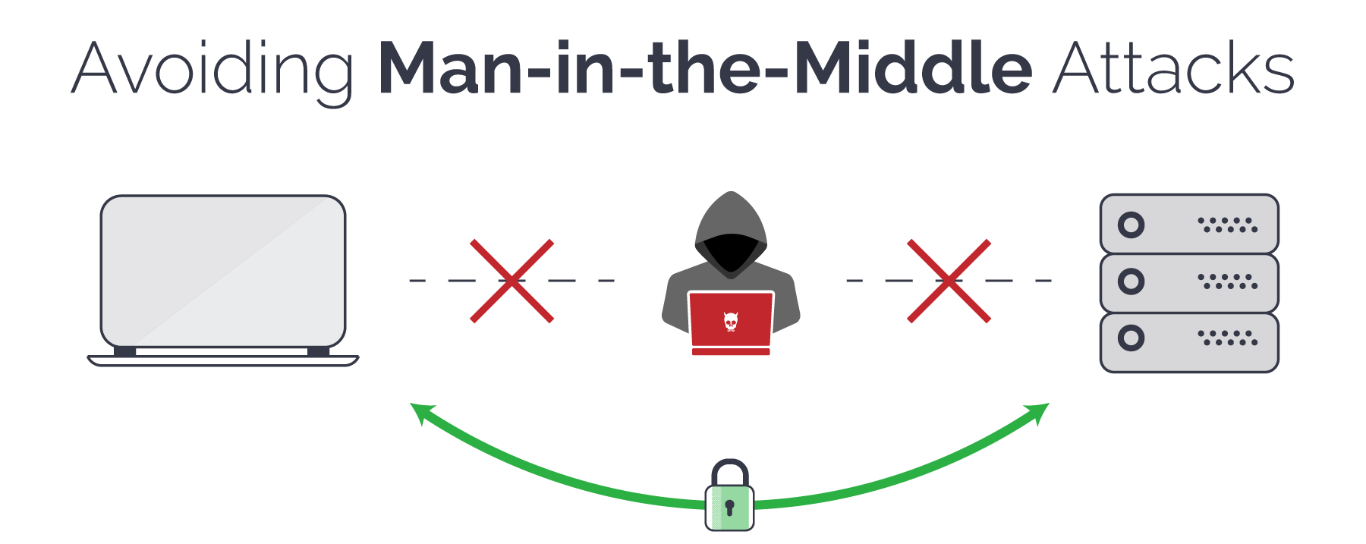
Protection against (MITM)
Notes:
Thank you, everyone, for the excellent presentation. Now, let's explore effective strategies to counter man-in-the-middle attacks.

Slide 33
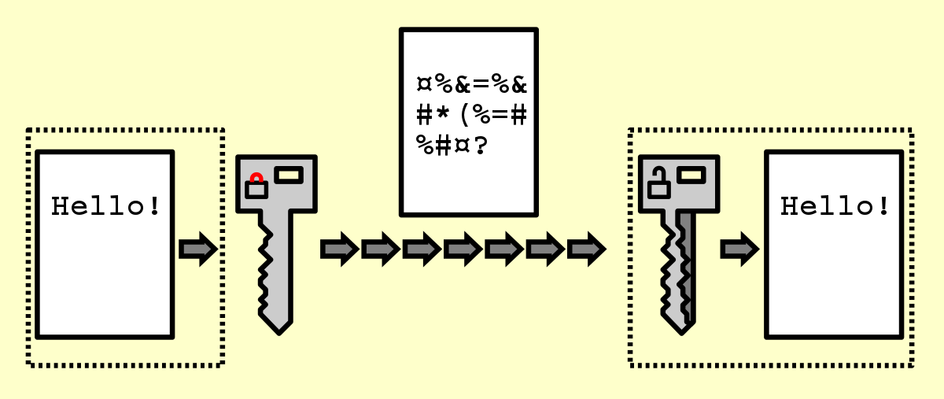
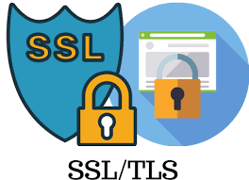
1. Strong Encryption
Notes:
Use strong encryption protocols like SSL/TLS (Secure Sockets Layer/Transport Layer Security) to encrypt the communication between your system and other devices or servers. This ensures that any intercepted data remains unreadable to the attacker.

Slide 34
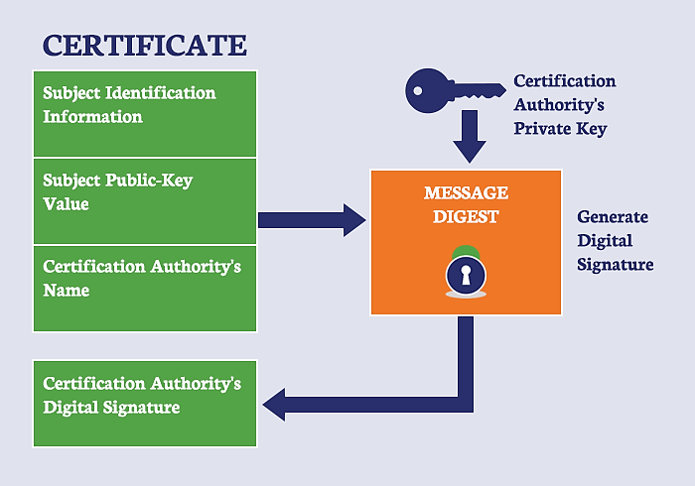
2. Certificate Validation
Notes:
Verify the authenticity of SSL/TLS certificates to ensure you are connecting to legitimate servers. Implement certificate pinning to bind specific certificates with the intended servers to prevent attackers from using forged or compromised certificates.

Slide 35
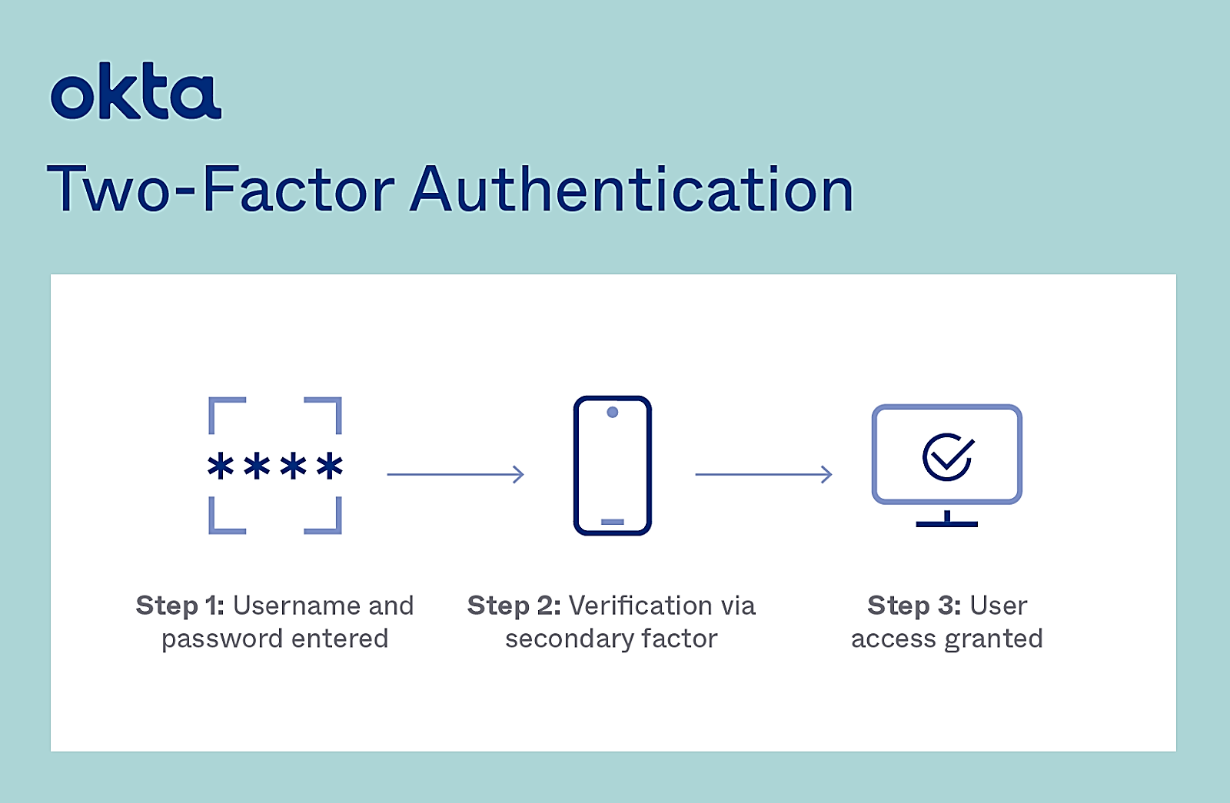
3. Two-Factor Authentication (2FA)
Notes:
Implement 2FA to add an extra layer of security. This involves using a second form of authentication, such as a one-time password (OTP) sent via SMS or generated by an authenticator app, in addition to the usual username and password.

Slide 36
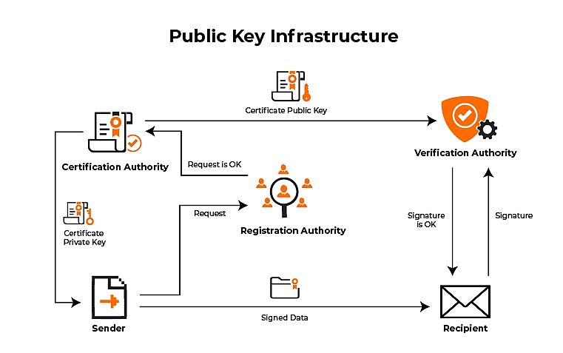
4. Public Key Infrastructure (PKI)
Notes:
Utilize PKI to securely manage and distribute digital certificates. PKI involves the use of a trusted third-party certificate authority (CA) to issue and validate digital certificates, ensuring the authenticity and integrity of communication channels.

Slide 37
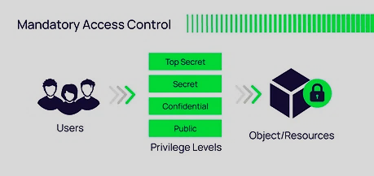
5. Strict Access Control
.
Notes:
Implement strong access controls and authentication mechanisms within your system. This includes using unique, complex passwords, limiting user privileges, and regularly updating access credentials.

Slide 38

6. Regular Software Updates
Notes:
Keep your system and applications up to date with the latest security patches. Vulnerabilities in software can be exploited by attackers to execute MITM attacks, so staying updated is crucial.

Slide 39
7. User Awareness and Education
Educate your system users about the risks of MITM attacks and how to identify and respond to suspicious activity. Encourage safe browsing habits, such as avoiding unsecured public Wi-Fi networks and being cautious while sharing sensitive information.

Slide 40
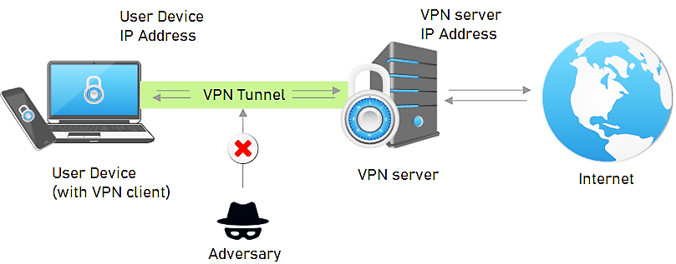
8. 8. Use Virtual Private Networks (VPNs)
Notes:
When accessing your system remotely, encourage users to employ VPNs. VPNs create an encrypted tunnel between the user's device and the system, protecting the data from interception and tampering.

Slide 41
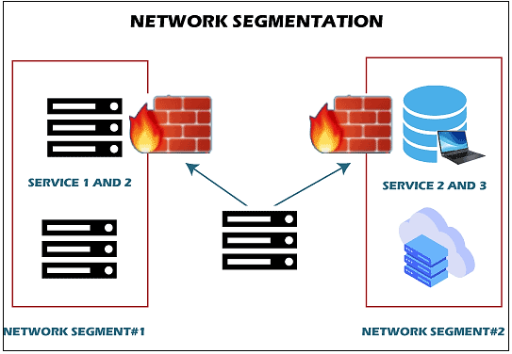
9. Network Segmentation
Notes:
Implement network segmentation to divide your system into separate segments or subnetworks. This helps restrict access and minimize the impact of a potential MITM attack by containing it within a specific segment.

Slide 42
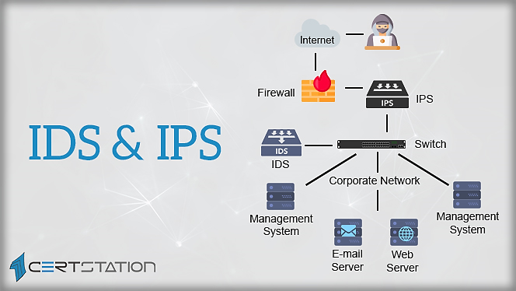





10. Intrusion Detection Systems (IDS) and Intrusion Prevention Systems (IPS)
Notes:
Utilize IDS/IPS solutions to monitor network traffic and identify any suspicious activity. These systems can detect and mitigate MITM attacks by analyzing network patterns and signatures.

Slide 43


Thanks for
watching

